Slide 1
The Battle of the Neighbourhood's - Prabhat Singh

Slide 2
Introduction where you discuss the business problem and who would be interested in this project.
"Would you recommend a location in NAVI MUMBAI to open a new cinema?“
My FRIEND, an investor wants to open a new cinema as company's new business and ask me this question.
He explains that in customer point of view, watching movie is a part of whole afternoon or night activities.

Slide 3
Cinema should has many restaurants and shopping places nearby. Transportation is also an important factor.
Customer can walk to cinema within 5 minutes from public transport facilities such as bus stop and metro station.
He wants me to concentrate on selection of cinema location according to its nearby environment.
Cinema facility and rental price is not my concern. He lists out his top 10 favorite cinemas in Navi Mumbai with rating.

Slide 4
I work with my teammates and select 5 possible locations to build the cinema. Which location should be suggested to the stakeholder?
Data
Data where you describe the data that will be used to solve the problem and the source of the data.
According to the question, I need to find following data to resolve the problem.
1. Geographic coordinate of Navi Mumbai cinemas
I need to compare 5 possible locations with current cinemas in Navi Mumbai . Therefore, I need to find a list of Navi Mumbai cinema and cinemas' geographic coordinates. Luckily, I can find the list and coordinates from the four Square site .

Slide 5
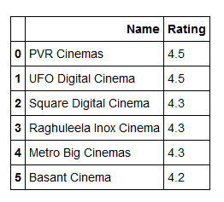
Finding the Distance and the top Cinema

Slide 6
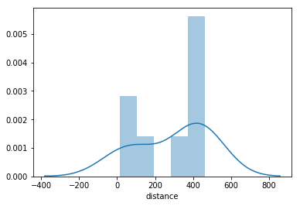
Finding the Distance and the top Cinema

Slide 7
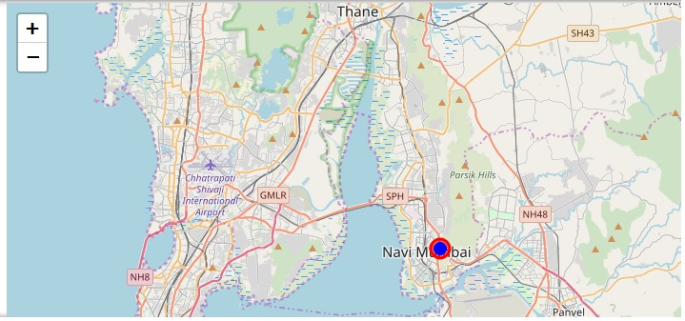
Found the Proper location to build a Cinema which is near to all the other categories which include Nigthclub, restaurant, parking etc

Slide 8
Thank You

